Slide 1
Prep and Housekeeping Items (Before Event Starts)
Note: as with any speed dating event, there is not a set expectation that you will be matched with a mentee following today’s event.
The purpose of the event today is to allow potential mentees learn about mentorship and what ISPE offers through the Mentor Match program, as well as opportunities for engagement within ISPE. And to get more ISPE members to sign up for the program ☺
MENTORS
  Change your screen name to include your full name
  Place the word MENTOR, followed by sector, before your zoom name (Example: MENTOR A – Daniela Moga)
    A = Academic
    G = Government/Regulatory
    I = Industry/Service Provider
    O = other
  Review potential discussion topics below
  Questions?
Event Agenda
TIME | ACTIVITY | LEADING
-0:15-0:00 | Prep and housekeeping items | All volunteers
0:00-0:10 | Welcome & Introduction to ISPE Mentorship Program | MC Chair (Daniela Moga)
0:10-0:30 | Remarks from ISPE’s President and President Elect | Mary Beth Ritchey and Ursula Kirchmayer
0:30-0:35 | What to expect in speed matching rounds | Daniela Moga
0:35-1:20 | Speed matching (up to 3 rounds) | All – breakout rooms
1:20-1:30 | Open discussion & wrap up | MC vice-chair (Anne Butler)
Ideas for potential discussion topics (for breakout rooms)
- What makes a good mentor or mentee?
- What topics/issues do you envision discussing with your mentor (For example: ISPE involvement, career trajectory/job opportunities, research advice)
- Do you seek a mentor that is in the same sector (e.g., industry vs. academia) or would a mentor from another sector provide valuable insights?
- What is your preferred mode and frequency of communication with mentors?

Slide 2
ISPE Virtual Mentor Match Event
3 & 5 June 2025
ISPE Membership Committee
Daniela Moga, Chair Membership Committee
Anne Butler, Co-Chair Membership Committee
Notes:
START RECORDING

Slide 3
Some Housekeeping:
Please mute yourself if you are not actively speaking
Turn on your video (we would love to see you!)
Tell us who you are:
  Please change your screen name to include your full name
  Mentors: Please place the word MENTOR, followed by sector, before your zoom name (Example: MENTOR A – Daniela Moga) – Sector key:
            A = Academic
            G = Government/Regulatory
            I = Industry/Service Provider
            O = Other
If you have questions, please send using the Chat function
All slides will be made available after the event on ISPE Exchange
Agenda
TIME | ACTIVITY | LEADING
0:00-0:10 | Welcome & Introduction to ISPE Mentorship (Mentor Match) Program | Daniela Moga
0:10-0:30 | Remarks from ISPE’s President and President Elect | Mary Beth Ritchey and Ursula Kirchmayer
0:30-0:35 | What to expect in speed matching rounds | Daniela Moga
0:35-1:20 | Speed matching (up to 3 rounds) | All – breakout rooms
1:20-1:30 | Open discussion & wrap up | Anne Butler

Slide 4

ISPE Mentor Match Program
ISPE is committed to professional development
Online networking and career development tool
Offers mentoring by senior ISPE members
Volunteer service
Use the simple online Mentor Match module to match up with a mentor
  - Through your ISPE Profile
https://community.pharmacoepi.org/participate/mentoring

Slide 5
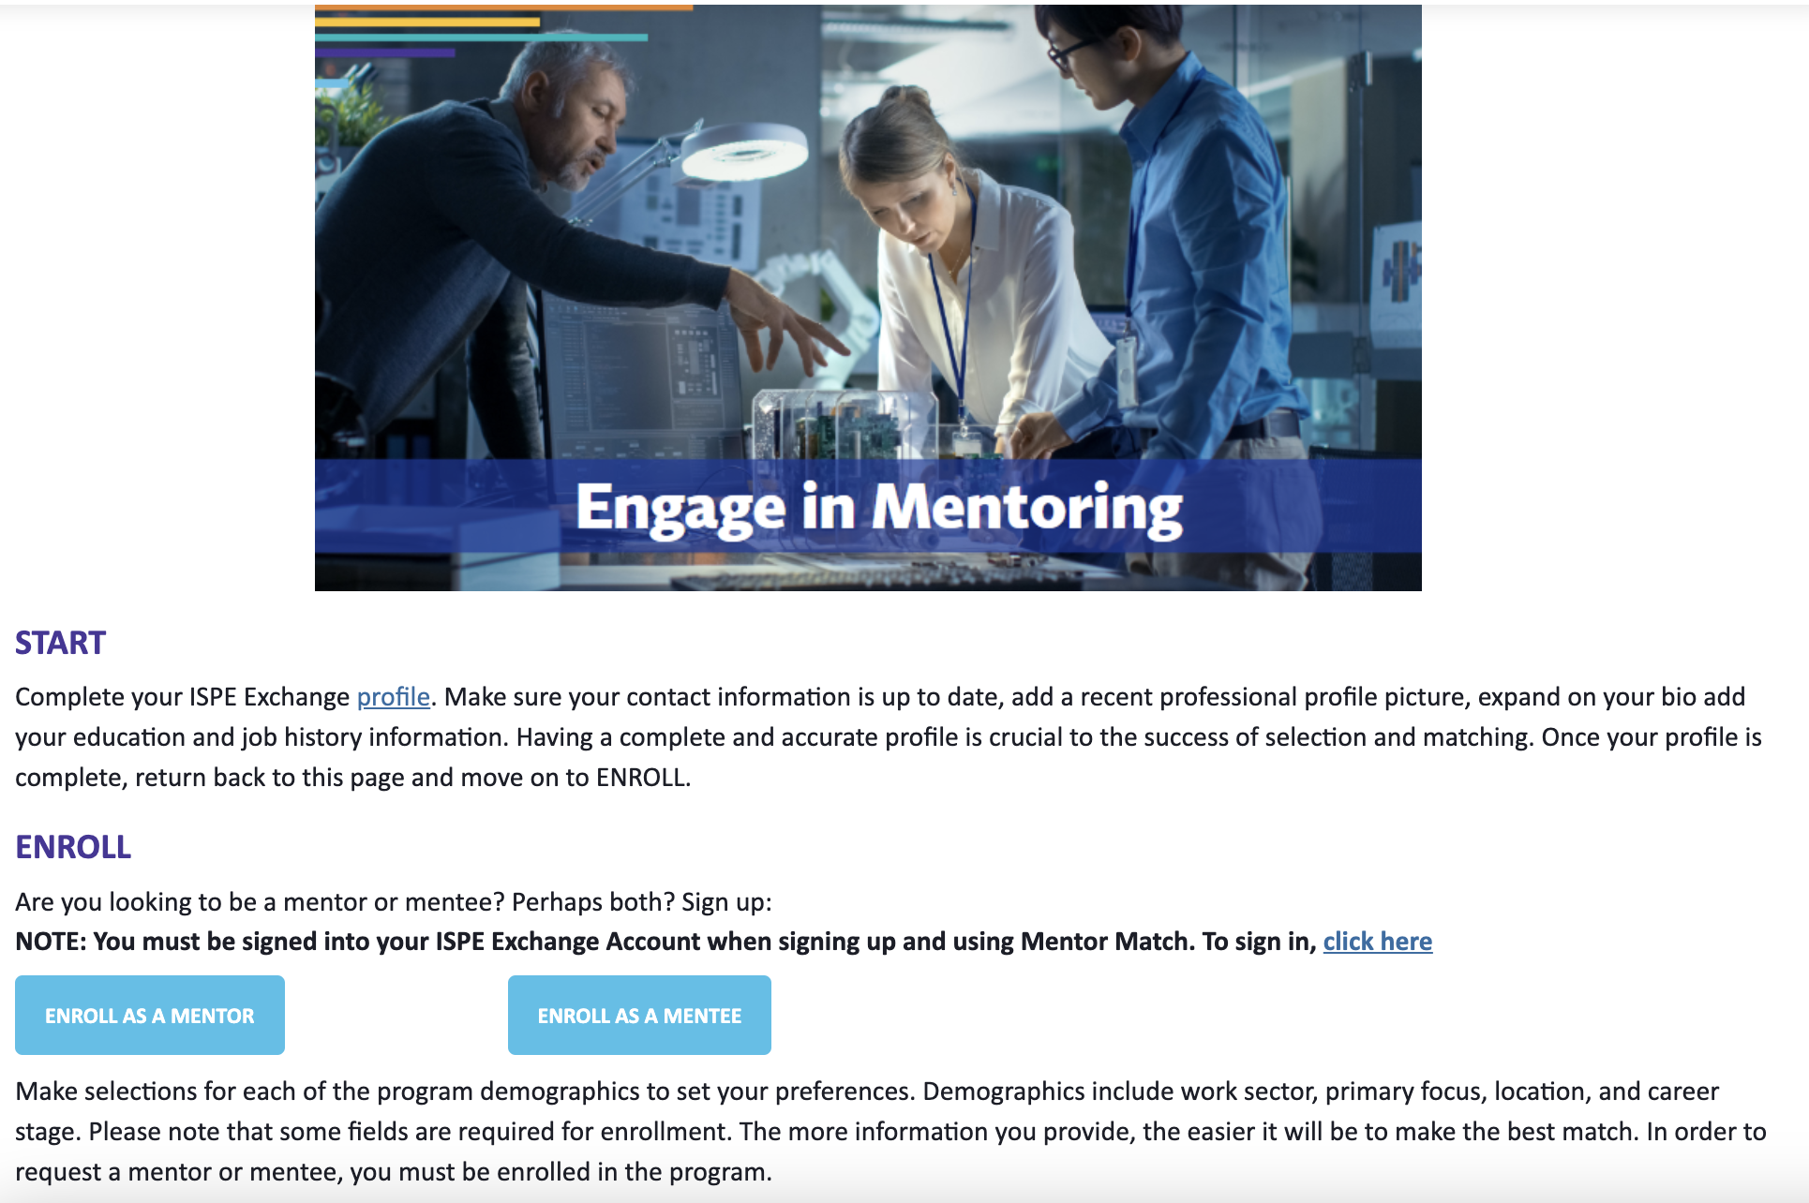
ISPE Mentor Match Program

Slide 6
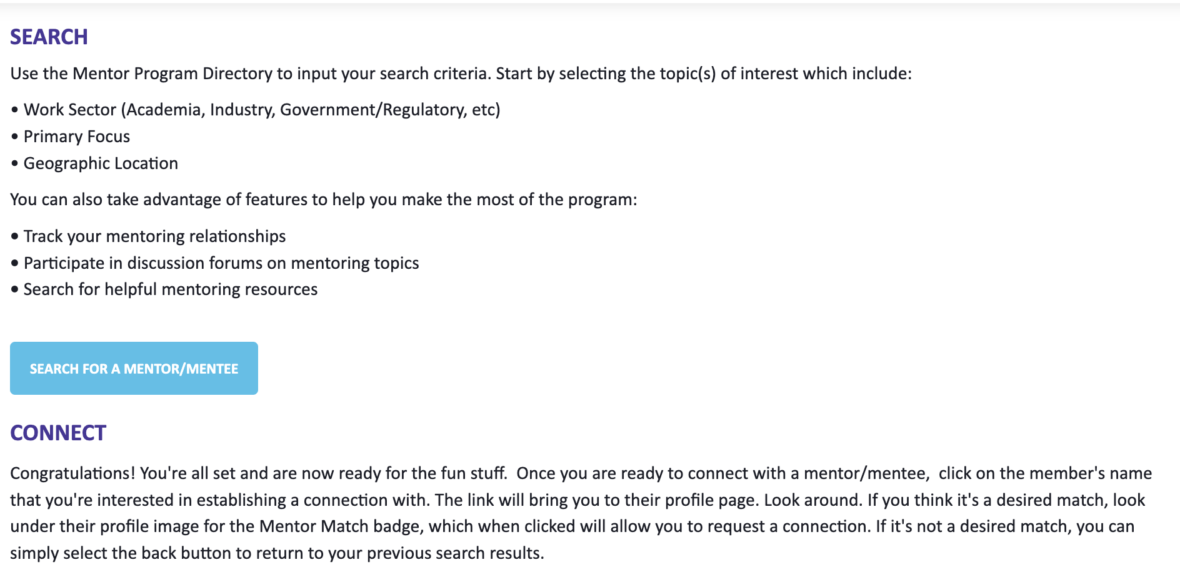
ISPE Mentor Match Program
https://community.pharmacoepi.org/participate/mentoring

Slide 7
ISPE Mentor Match Program
Search through the list of potential matches using the online tool
Mentees: Be proactive about messaging a potential mentor(s) and set up a time for an initial call
Anyone can be a Mentor and a Mentee, you can sign up to be both

Slide 8
ISPE President Mary Beth Ritchey
and
ISPE President-Elect Ursula Kirchmayer

Slide 9
ISPE 2025 Mentor-Mentee Match
Mary Beth Ritchey, PhD, FISPE
ISPE President 2024-2025

Slide 10

Hello!
A little about me… disclosures…

Slide 11
Defining the Landscape
Mentoring
Coaching
Sponsoring

Slide 12
Opportunities from Great Mentoring Relationships
Career Acceleration
Skill and Perspective Development
Confidence and Support
Figure. 70-20-10 Rule of Learning

Slide 13
Challenges When Mentoring Goes Wrong
Dependency and Stunted Growth
Misaligned Expectations
Power Dynamics and Politics
Quality and Compatibility Issues
Warning Signs:
- Mentors make it about them
- Transactional nature
- Advice consistency feels wrong

Slide 14
Successful Mentoring
Mentee
  Proactive approach
  Show appreciation
  Seek diverse perspectives
  Pay it forward
  Build a portfolio
Mentor
  Set clear boundaries
  Focus on their growth
  Stay current
  Know when to let go

Slide 15
Be both! Mentor and Mentee!

Slide 16
Speed matching

Slide 17
What to expect
5 mins
Introduction to the session
15 mins
Breakout rooms
Option to transition to new room
15 mins
Breakout rooms
Option to transition to new room
15 mins
Breakout rooms
10 mins
Discussion and wrap up
15-minute speed matching rounds
At the end of each round, you can choose to:
1) Switch to another room (see instructions below)
2) Stay in your existing room (do nothing!)
To switch rooms
In Zoom controls:
Select “Breakout Rooms” (may need to select the “More” icon to find) – see screenshots below
Choose another room you want to join, then click “Join Room”
To come back to main room, select “Leave Breakout Room”
Any issues or get disconnected?
Come back to main room or re-join event
08
Notes:
Remind folks to take their own screenshot of this slide. “If you happen to get disconnected or if anything goes wrong, re-join the meeting.”

Slide 18
Potential topics for discussion
First, briefly introduce yourselves, then…
What makes a good mentor or mentee?
What topics/issues do you envision discussing with your mentor
For example: ISPE involvement, career trajectory/job opportunities, research advice
Do you seek a mentor that is in the same sector (e.g., industry vs. academia) or would a mentor from another sector provide valuable insights?
What is your preferred mode and frequency of communication with mentors?
09

Slide 19
Ready, Set, Breakout!
Reminder: To switch rooms at the end of each round...
In Zoom controls:
Select “Breakout Rooms” (may need to select the “More” icon to find)
Choose another room you want to join, then click “Join Room”
To come back to main room, select “Leave Breakout Room”
Mentor Sector Key
A = Academic
G = Government/Regulatory
I = Industry/Service Provider
O = Other
Notes:
STOP RECORDING

Slide 20
Discussion and Wrap-up

Slide 21

Is there anything you discussed that would be useful to share with the group?
Are there any questions which came up?

Slide 22
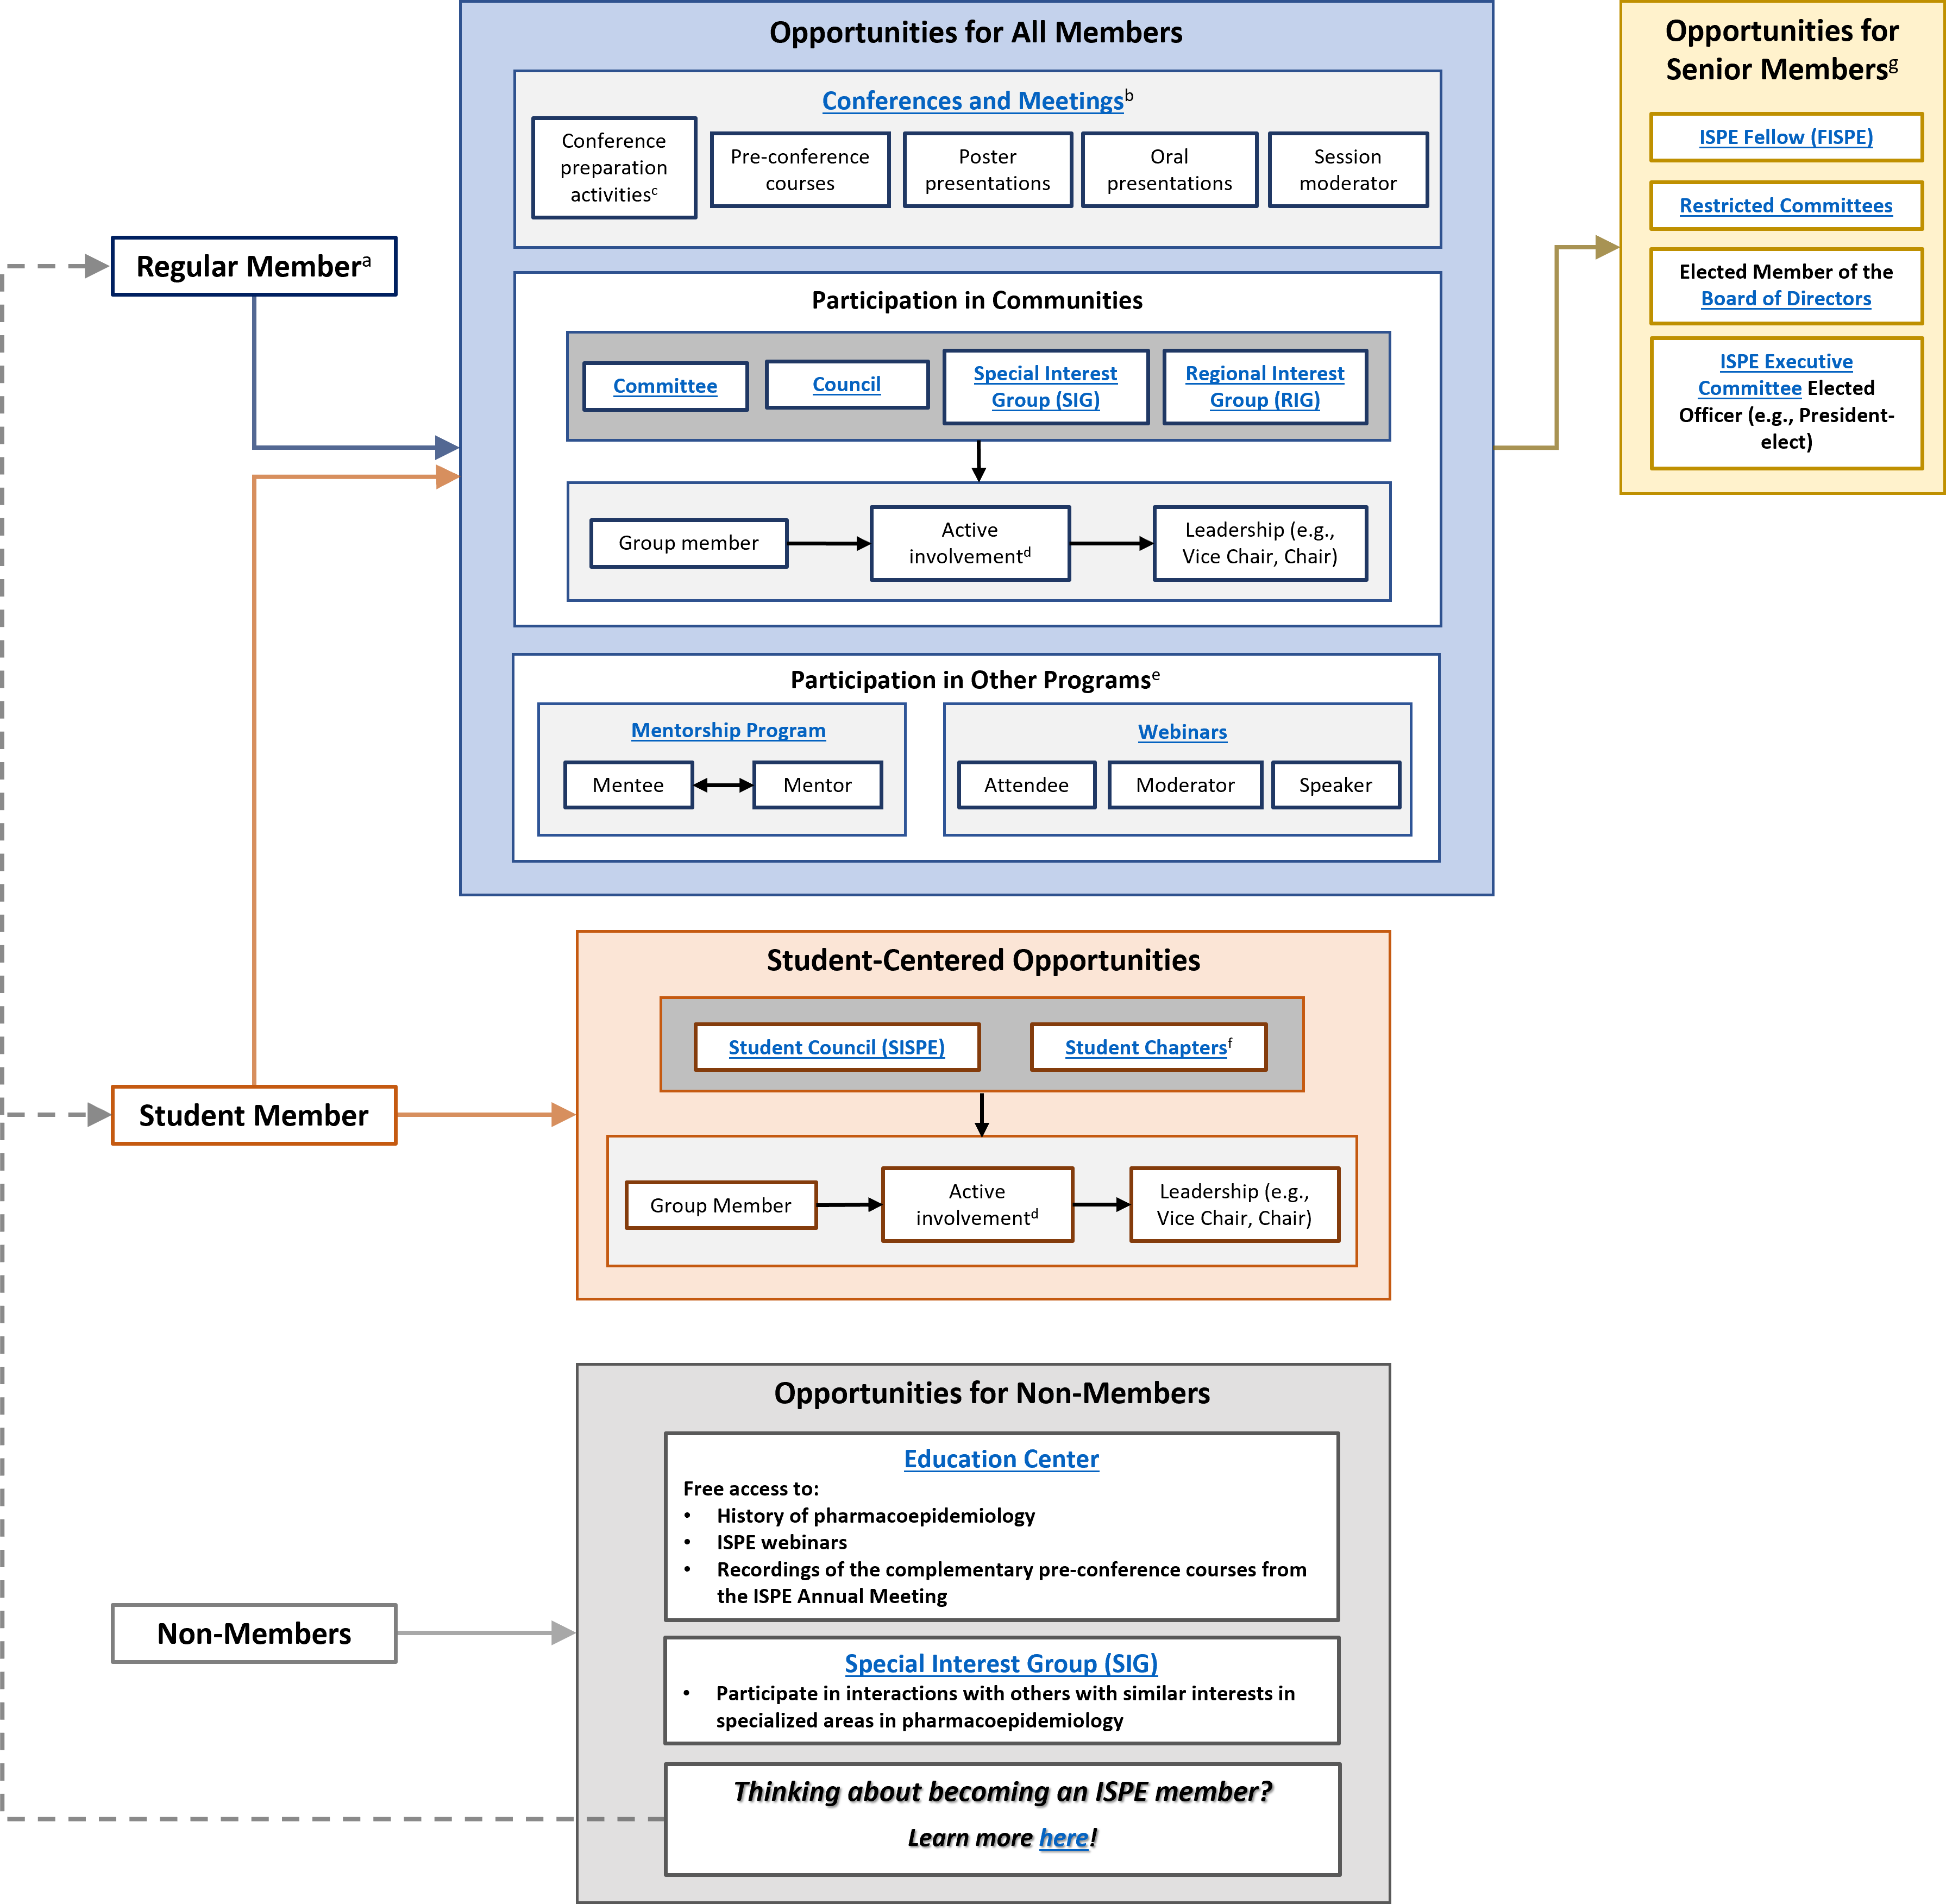
More opportunities
to get involved
with ISPE:
https://www.pharmacoepi.org/get-involved/overview/

Slide 23
Acknowledgements
ISPE President, Mary Beth Ritchey, and President Elect, Ursula Kirchmayer
ISPE Membership Committee vice-chair, Anne Butler
ISPE Membership Committee members
All Mentor volunteers
Hannah Lier and the Impact staff

Slide 24
Thank you for attending!
If you have any questions about the Mentor Match Program or other opportunities for engagement within ISPE, please email us at:
info@pharmacoepi.org

